Slide 1
ISEC Lecture 5a Authentication Management
Ref: Textbook
Chap 11 - Authentication and Account Management

Slide 2
Objectives
11.1 Describe the different types of authentication credentials

Slide 3
Authentication Credentials (1 of 2)
Types of authentication credentials
What you know
Example: combination to health club locker
What you have
Example: key fob to lock your car
What you are
Example: facial characteristics recognized
What you do
Example: do something to prove authenticity
Where you are
Example: a military base

Slide 4
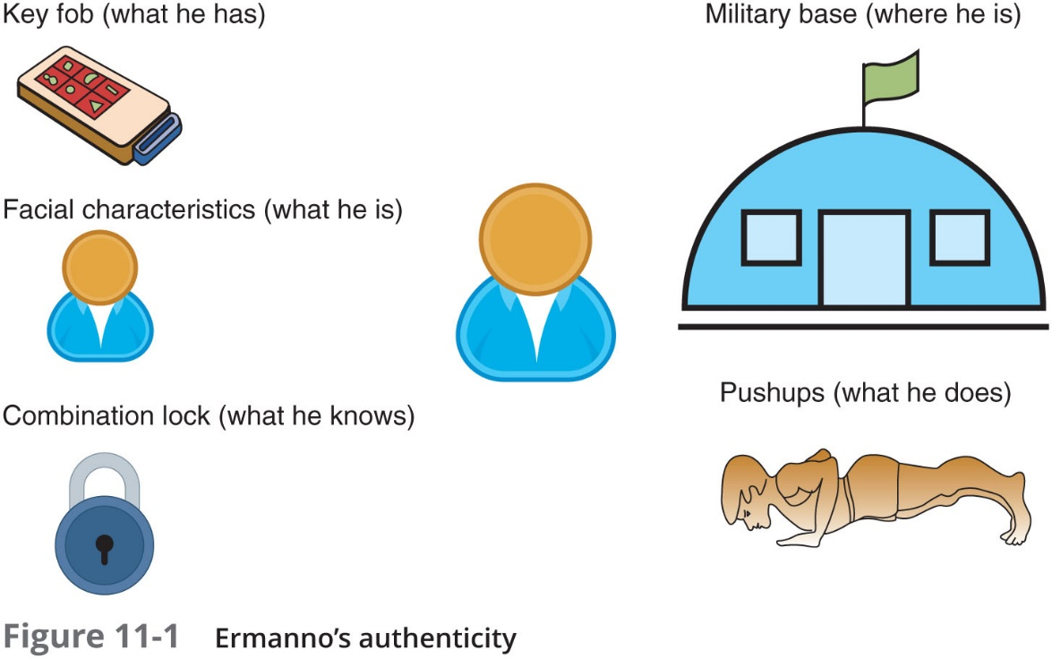
Authentication Credentials (2 of 2)

Slide 5
What You Know: Passwords
User logging in to a system
Asked to identify himself
User enters username
User asked to authenticate
User enters password
Passwords are the most common type of authentication today
Passwords provide only weak protection
Actions can be taken to strengthen passwords

Slide 6
Password Weaknesses (1 of 3)
Weakness of passwords is linked to human memory
Humans can memorize only a limited number of items
Long, complex passwords are most effective
Most difficult to memorize
Users must remember passwords for many different accounts
Each account password should be unique
Security policies mandate passwords must expire
Users must repeatedly memorize passwords

Slide 7
Password Weaknesses (2 of 3)
Users often take shortcuts
Using a weak password
Examples: common words, short password, or personal information
When attempting to create stronger passwords, they generally follow predictable patterns:
Appending: using letters, numbers, and punctuation in a pattern
Replacing: users use replacements in predictable patterns

Slide 8
Password Weaknesses (3 of 3)
Rank | Password
1 | 123456
2 | 123456789
3 | abc123
4 | password
5 | password1
6 | 12345678
7 | 111111
8 | 1234567
9 | 12345
10 | 1234567890

Slide 9
Attacks on Passwords (1 of 8)
Attacks that can be used to discover passwords:
Social engineering
Phishing, shoulder surfing, dumpster diving
Capturing
Keylogger, protocol analyzer
Man-in-the-middle and replay attacks
Resetting
Attacker gains physical access to computer and resets password

Slide 10
Attacks on Passwords (2 of 8)
Offline attack
Method used by most password attacks today
Attackers steal file of password digests
Compare with their own digests they have created
Offline password attacks include:
Brute force
Mask
Rule
Dictionary
Rainbow tables
Password collections

Slide 11
Attacks on Passwords (3 of 8)
Brute force
Every possible combination of letters, numbers, and characters used to create encrypted passwords and matched against stolen file
Slowest, most thorough method
NTLM (New Technology LAN Manager) hash
An attacker who can steal the digest of an NTLM password would not need to try to break it
He would simply pretend to be the user and send that hash to the remote system to then be authenticated
Known as a pass the hash attack

Slide 12
Attacks on Passwords (4 of 8)
Mask Attack
A more targeted brute force attack that uses placeholders for characters in certain positions of the password
Parameters that can be entered in a mask attack include:
Password length
Character set
Language
Pattern
Skips (nonsensical combinations)
Rule Attack
Conducts a statistical analysis on the stolen passwords that is then used to create a mask to break the largest number of passwords

Slide 13
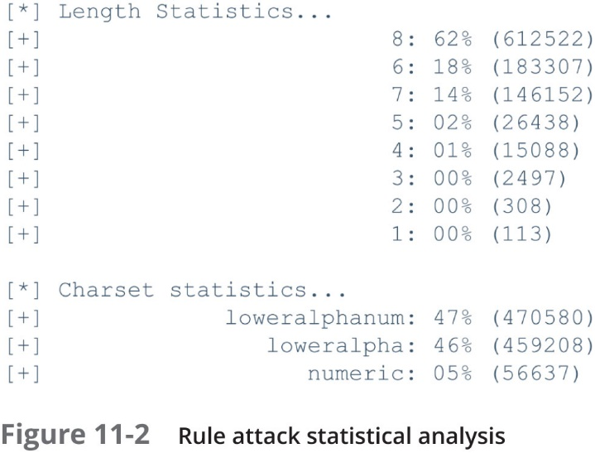
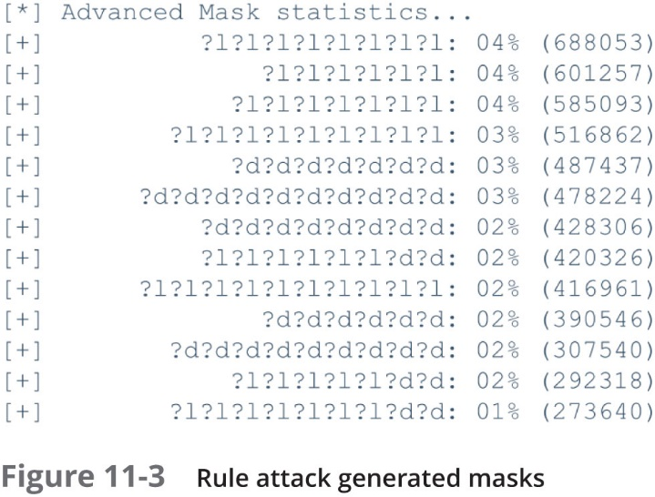
Attacks on Passwords (5 of 8)

Slide 14
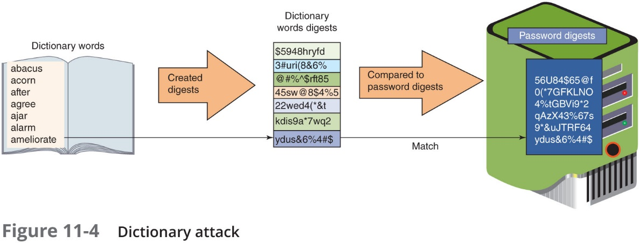
Attacks on Passwords (6 of 8)
Dictionary Attack
Attacker creates digests of common dictionary words
Compares against stolen digest file
Pre-image attack - a dictionary attack that uses a set of dictionary words and compares it with the stolen digests
Birthday attack - the search for any two digests that are the same

Slide 15
Attacks on Passwords (7 of 8)
Rainbow Tables
Creates a large pregenerated data set of candidate digests
Rainbow table advantages over other attack methods
Can be used repeatedly
Faster than dictionary attacks
Less memory on the attacking machine is required

Slide 16
Attacks on Passwords (8 of 8)
Password Collections
In 2009, an attacker used an SQL injection attack and more than 32 million user passwords (in cleartext) were stolen
These passwords provided two key elements for password attacks:
Gave attackers a large corpus of real-world passwords
Have provided attackers advanced insight into the strategic thinking of how users create passwords

Slide 17
Password Security (1 of 5)
Securing passwords from attacks depends upon the user as well as the enterprise
For the user
It involves properly managing passwords
For the enterprise
It involves protecting password digests

Slide 18
Password Security (2 of 5)
Managing Passwords
Most critical factor in a strong password is length
In addition to having long passwords, other recommendations are:
Do not use passwords that consist of dictionary words or phonetic words
Do not repeat characters or use sequences
Do not use birthdays, family member names, pet names, addresses, or any personal information
Also, use non-keyboard characters
Created by holding down the ALT key while typing a number on the numeric keypad

Slide 19
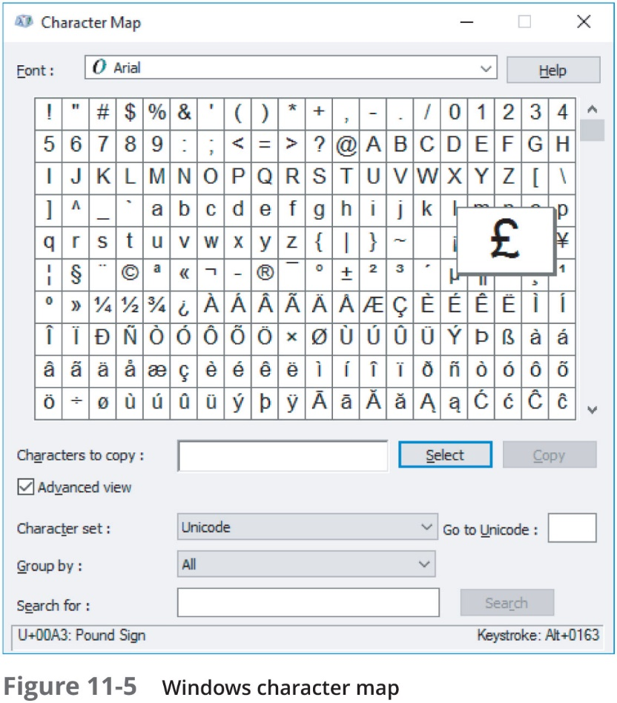
Password Security (3 of 5)

Slide 20
Password Security (4 of 5)
Password managers
Technology used for securing passwords
Three basic types of password manager:
Password generators
Online vaults
Password management applications
Protecting Password Digests
One method is to use salts
Consists of a random string that is used in hash algorithms
Passwords can be protected by adding a random string to the user’s cleartext password before it is hashed
Make dictionary attacks and brute force attacks much slower and limit the impact of rainbow tables

Slide 21
Password Security (5 of 5)
Protecting Password Digests (continued)
Another method is to use key stretching
A specialized password hash algorithm that is intentionally designed to be slower
Two key stretching algorithms: bcrypt and P B K D F 2
Recommendation for enterprises using salts and key stretching:
Use a strong random number generator to create a salt of at least 128 bits
Input the salt and the user’s plaintext password into the P B K D F 2 algorithm that is using H M A C-S H A-256 as the core hash
Perform at least 30,000 iterations on P B K D F 2
Capture the first 256 bits of output from P B K D F 2 as the password digest
Store the iteration count, the salt, and the password digest in a secure password database

Slide 22
What You Have: Tokens, Cards, and Cell Phones
Multifactor authentication
When a user is using more than one type of authentication credential
Example: what a user knows and what a user has could be used together for authentication
Single-factor authentication
Using just one type of authentication
Most common items used for authentication:
Tokens, cards, and cell phones

Slide 23
Tokens (1 of 3)
Tokens
Used to create a one-time password (O T P)
Authentication code that can be used only once or for a limited period of time
Hardware security token
Typically a small device with a window display
Software security token
Stored on a general-purpose device like a laptop computer or smartphone
Two types of O T P s
Time-based one-time password (T O T P)
Synched with an authentication server
Code is generated from an algorithm
Code changes every 30 to 60 seconds

Slide 24
Tokens (2 of 3)
Two types of O T P s (continued)
HMAC-based one-time password (H O T P)
“Event-driven” and changes when a specific event occurs
Advantages over passwords
Token code changes frequently
Attacker would have to crack code within time limit
User may not know if password has been stolen
If token is stolen, it becomes obvious and steps could be taken to disable account

Slide 25
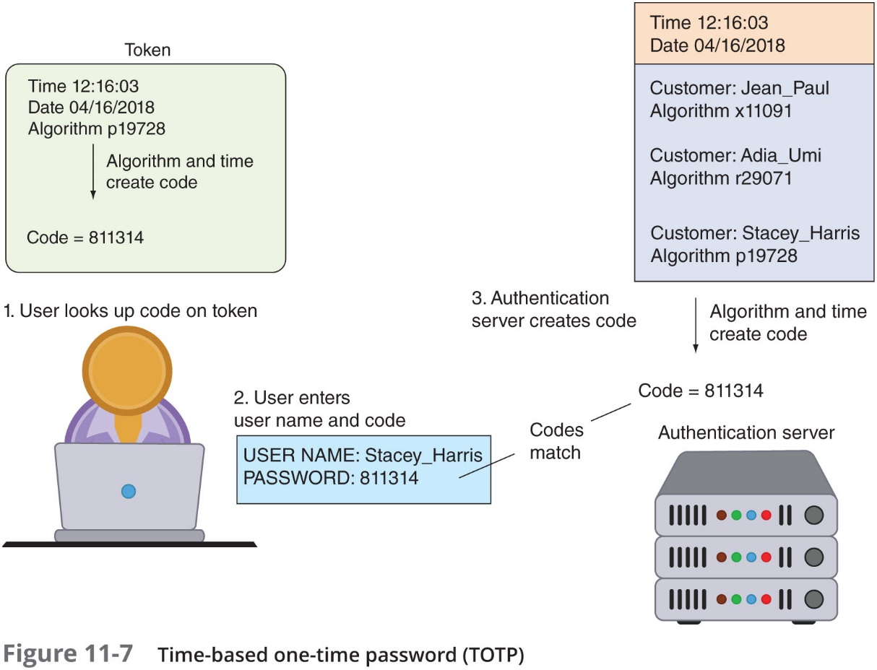
Tokens (3 of 3)

Slide 26
Cards (1 of 2)
Smart card contains integrated circuit chip that holds information and can be either:
Contact card – a “pad” that allows electronic access to chip contents
Contactless cards (proximity cards)
Require no physical access to the card
Common access card (C A C)
Issued by U S Department of Defense
Bar code, magnetic strip, and bearer’s picture

Slide 27
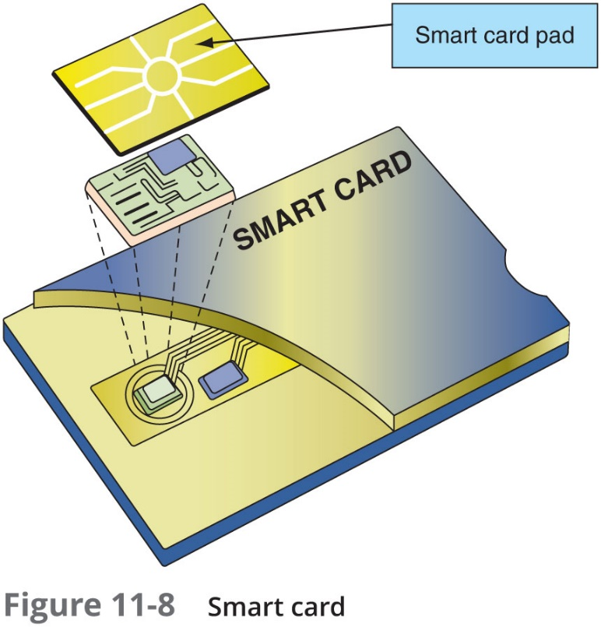
Cards (2 of 2)

Slide 28
Cell Phones
Cell Phones are increasingly replacing tokens and cards
A code can be sent to a user’s cell phone through an app on the device or as a text message when using TOTP
Also allow a user to send a request via the phone to receive an H O T P authorization code

Slide 29
What You Are: Biometrics (1 of 3)
Standard biometrics
Uses a person’s unique physical characteristics for authentication
Face, hand, or eye characteristics are used to authenticate
Specialized Biometric Scanners
Retinal scanner uses the human retina as a biometric identifier
Maps the unique patterns of a retina by directing a beam of low-energy infrared light (I R) into a person’s eye
Fingerprint scanner types
Static fingerprint scanner - takes a picture and compares with image on file
Dynamic fingerprint scanner - uses small slit or opening

Slide 30
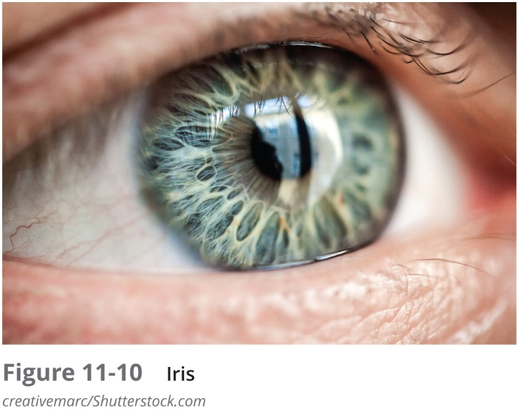
Standard Biometrics (2 of 3)
Standard Input Devices
Voice recognition uses a standard computer microphone to identify users based on the unique characteristics of a person’s voice
Iris scanner uses a standard webcam to identify the unique characteristics of the iris
Facial recognition uses landmarks called nodal points on human faces for authentication

Slide 31
Standard Biometrics (3 of 3)
Biometric Disadvantages
Cost of hardware scanning devices
Readers have some amount of error
Reject authorized users
Accept unauthorized users
Biometric systems can be “tricked”

Slide 32
What You Do: Behavioral Biometrics (1 of 2)
Behavioral biometrics
Authenticates by normal actions the user performs
Keystroke dynamics
Attempts to recognize user’s typing rhythm
All users type at a different pace
Provides up to 98 percent accuracy
Uses two unique typing variables
Dwell time (time it takes to press and release a key)
Flight time (time between keystrokes)
Holds a great amount of potential
It requires no specialized hardware

Slide 33
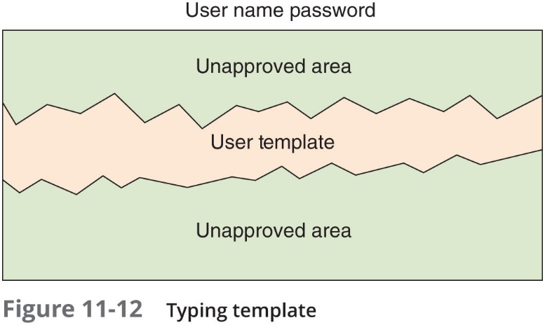
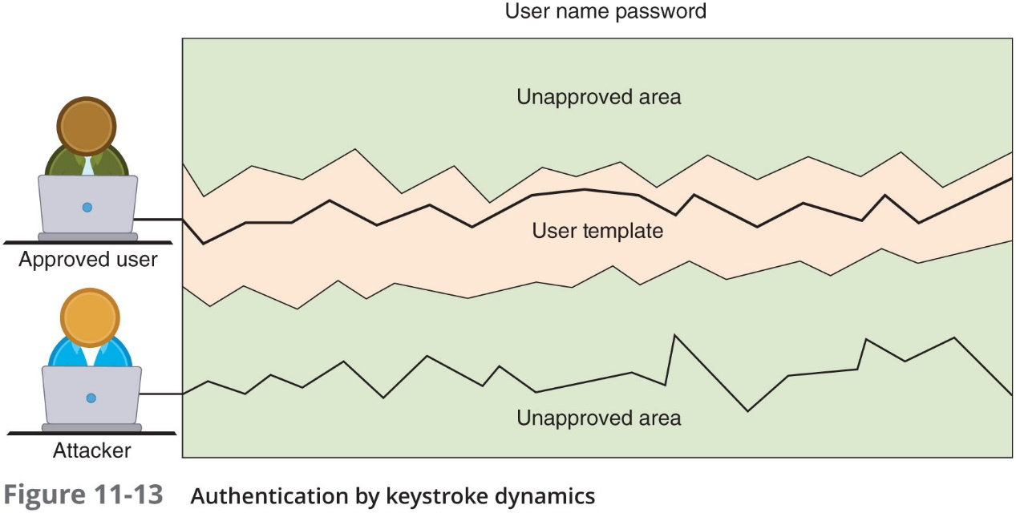
What You Do: Behavioral Biometrics (2 of 2)

Slide 34
Where You Are: Geolocation
Geolocation
The identification of the location of a person or object using technology
Used most often to reject imposters instead of accepting authorized users
Can indicate if an attacker is trying to perform a malicious action from a location different from the normal location of the user
Many websites will not allow a user to access an account if the computer is located in a different state
Some websites may require a second type of authentication
A code sent as a text message to a cell phone number on file

Slide 35
Chapter Summary
Authentication credentials can be classified into five categories: what you know, what you have, what you are, what you do, and where you are
Passwords provide a weak degree of protection
Must rely on human memory
Most password attacks today use offline attacks
Attackers steal encrypted password file
A dictionary attack begins with the attacker creating digests of common dictionary words, which are compared with those in a stolen password file
Securing passwords from attacks depends upon the user as well as the enterprise
Security experts recommend that technology be used to store and manage passwords called password managers

